Slide 1




Characterizing the decision landscape to identify opportunities and barriers for climate adaptation in oyster aquaculture in Wellfleet, Massachusetts
Seth Tuler
Interdisciplinary and Global Studies Division
Worcester Polytechnic Institute, Worcester, MA
Funding provided by NOAA Coastal and Ocean
Climate Applications Program
(NA12OAR4310106)
National Adaptation Forum, 13 May 2015

Slide 2
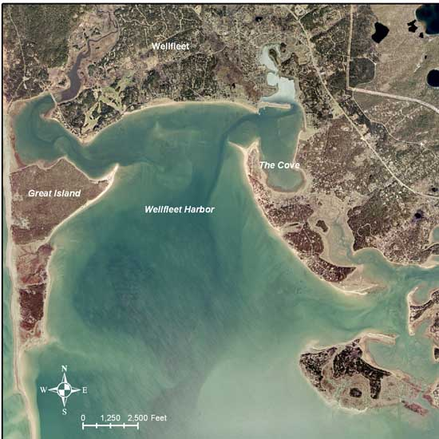
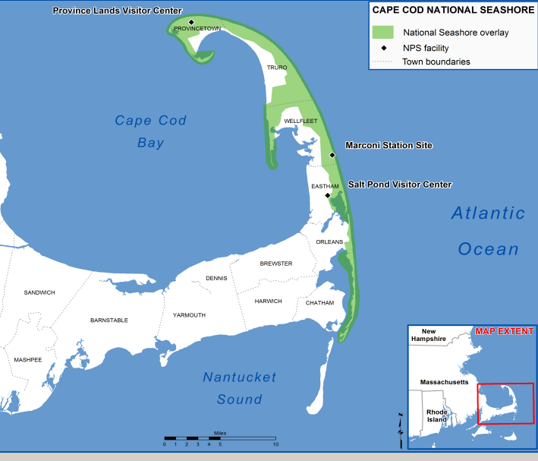
Wellfleet, MA

Slide 3
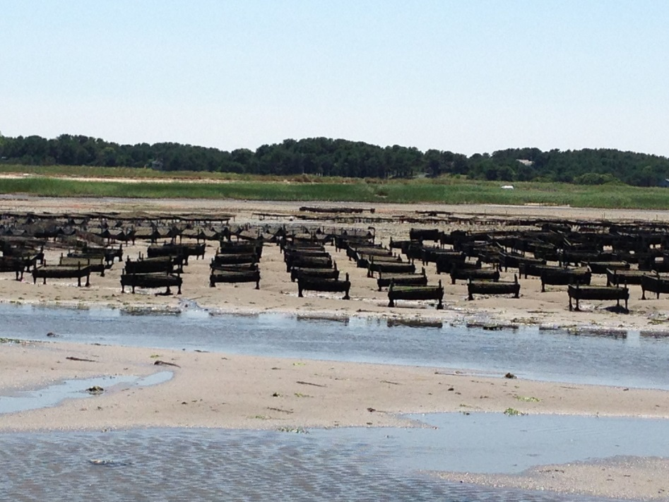
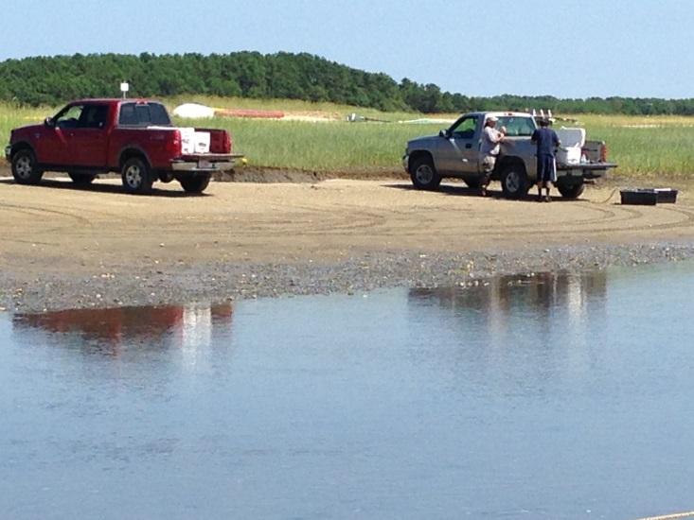
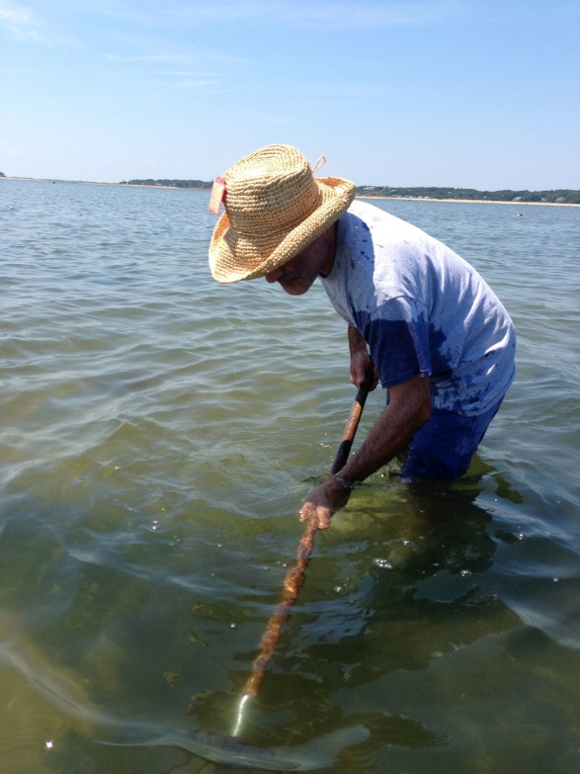
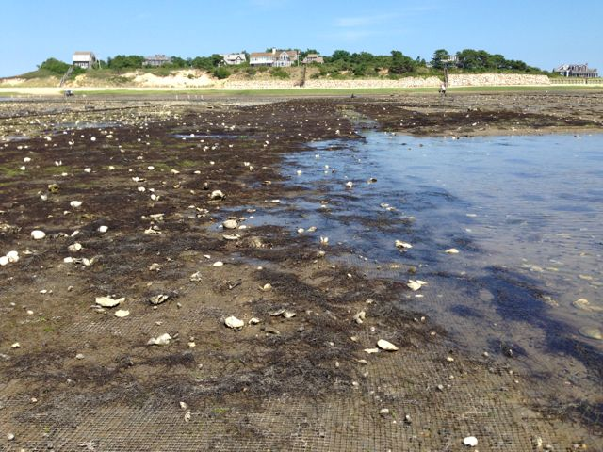
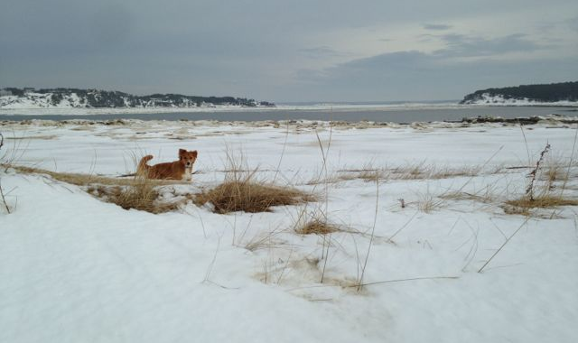
Notes:
Almost 100 acres of Wellfleet’s estuaries are dedicated to oyster and quahog aquaculture (about 20% of state total).
Approximately 100 commercial aquaculture grants, plus wild harvesters and recreational pickers.
In 2014 the town’s commercial oyster harvest was about 8 million (about 19 million statewide).
Oysters grown far outnumber quahogs.

Slide 4
Working Group on Climate Change Impacts on Shellfishing in Wellfleet Harbor
Identify
  Threats to shellfishing in Wellfleet Harbor from climate change
  Strategies to increase the resilience of Wellfleet and its shellfishery
  The role of shellfish in mitigating impacts from climate change and other environmental hazards in Wellfleet Harbor
Using
  VCAPS
  Systems dynamics modeling
  GIS mapping
The only place for longterm, multi-board discussions in town

Slide 5
Participants, 10-12 per meeting
  Shellfish Advisory Board, Wastewater Planning Committee, Conservation Commission, Board of Health, Wellfleet Bay Audubon Sanctuary, MA Aquaculture Association, oyster growers, quahog growers, Shellfish researchers, coastal/marine scientists
VCAPS Process
  Summer 2013 - 2015, 6 meetings
  Iteration between state of science presentations and discussion
  Impacts of sea level rise and storm surge
  Warming temperatures (vibrio)

Slide 6
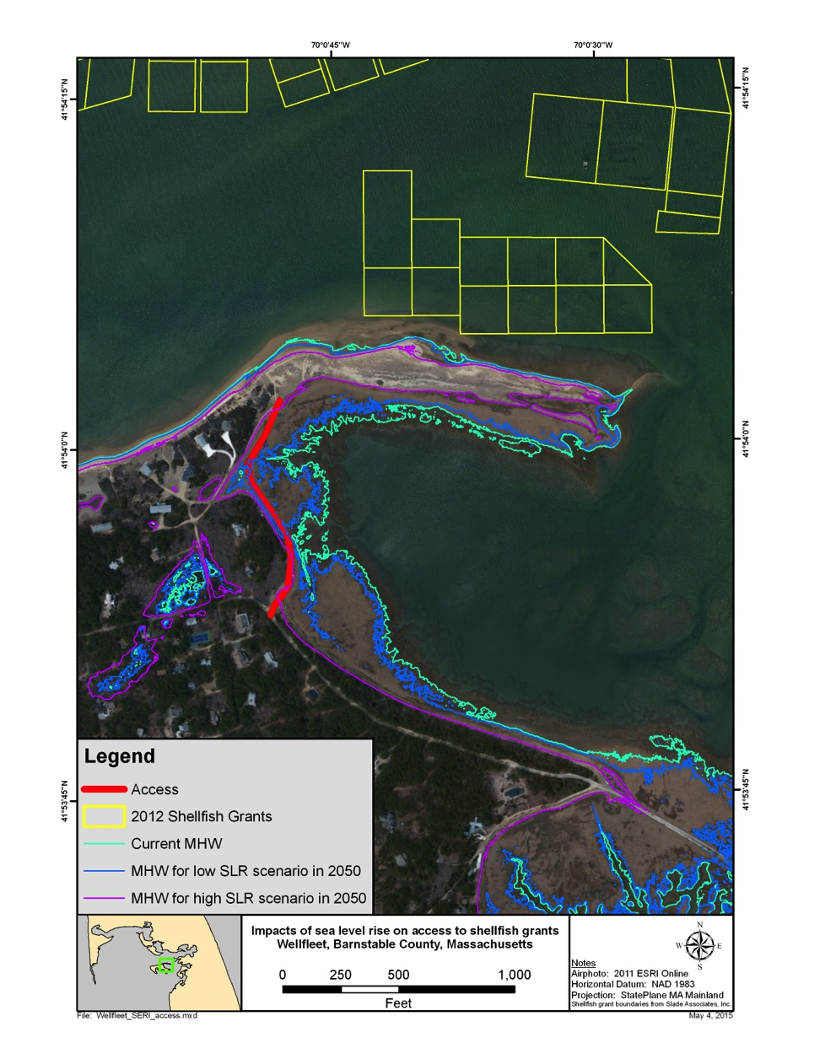
Potential impacts of climate change
On shellfish
  Loss of habitat
  More stormwater and wastewater runoff
  Change in water chemistry
  Change in food supplies
  Change in predator populations
  Increases in stress and disease
On the shellfishery and public health
  Impaired access to grants
  Poor quality product
  Increases in health risks
  Loss of income
  Need to shift how grow shellfish
  More burdensome rules

Slide 7
Many non-climate stressors
Nutrient loading
Lack of diversity of seed
More intense farming
Shoreline development, armoring, and erosion

Slide 8
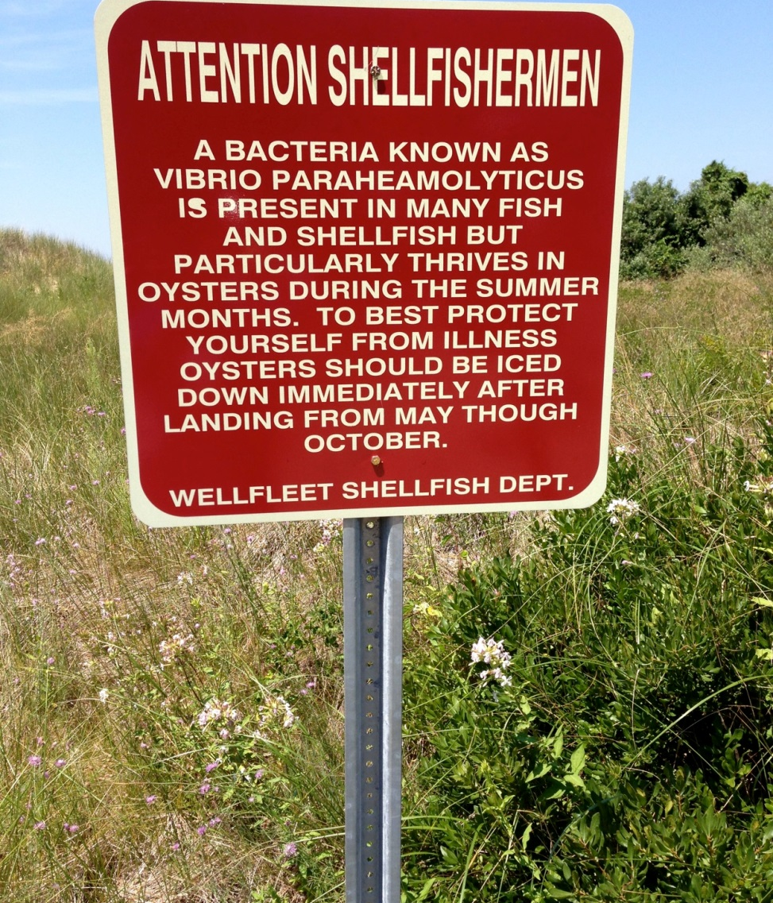
Making sense of what to do
Many potential management actions identified.
Prioritization, design, implementation will involve multiple actors at different scales of governance.
Describe the decision landscape
  A representation of features of a decision making context

Slide 9
Decision landscape elements
  The actions and their implications (decision making, planning, or implementation process)
  The agents involved in the action (including those that are interested or affected)
  The purposes and preferences of the actors
  The resources available (or not) to the actors
  The scene of the action (including governance regimes, social context, etc.)

Slide 10
A focus on actors, purposes, and actions
Climate impact | Shellfish Advisory Board | Board of Health | Waste water Manag. Planning Committee | Con Com | Marina Advisory Committee | Natural Resource Advisory Board | Planning Board | Select board | State agencies (DMF, DPH) | Federal agencies (NPS)
SLR / flooding
Saltwater intrusion
Erosion

Slide 11
Decision landscape of shellfish in Wellfleet Harbor
Protect shoreline and improve water quality with oyster reefs
    But reefs lack longterm protection from (Shellfish Warden, MA DMF)
Reduce coastal erosion and improve water quality by protecting and restoring marsh habitat
      But growers’ access is by vehicle and access is already impacted by erosion and
      Recreational users of harbor crowed the same access points
Manage Vp risk
  But illness caused by recreational picking could lead to closure of commercial beds.

Slide 12
Structuring the landscape to support planning
Informative and useful
  Identify gaps, constraints, and conflicts
  Clarify limits of power
  Illustrate futility of managing for shellfish in isolation, but how shellfish can be ‘the hook’ for longterm planning
  Highlight opportunities for co-benefits
    Highlight opportunities (need!) for coordination
  Develop support across horizontal and vertical actor boundaries

